Slide 1

SPRING BOOT × AI
Developing Smart Web Apps with Spring Boot & AI
Session 2: Clean/Hexagonal Architecture - Spring AI

Slide 2

Clean/Hexagonal Architecture
01

Slide 3
Software Architect Pattern
01.1
Software architecture của hệ thống mô tả các component chính, mối quan hệ của chúng, và cách chúng tương tác với nhau. Nó được xem như một bản thiết kế chi tiết, cung cấp mô hình để quản lý hệ thống và thiế lập cũng như điều phối giao tiếp giữa các component.
Một số software architect phổ biến: N-Tier (Layered Architecture) Microservice Architecture
Domain Driven Design (DDD Architecture) Hexagonal/Clean Architecture
Tham khảo: https://bytebytego.com/guides/top-5-software-architectural-patterns/
CLEAN/HEXAGONAL ARCHITECTURE

Slide 4
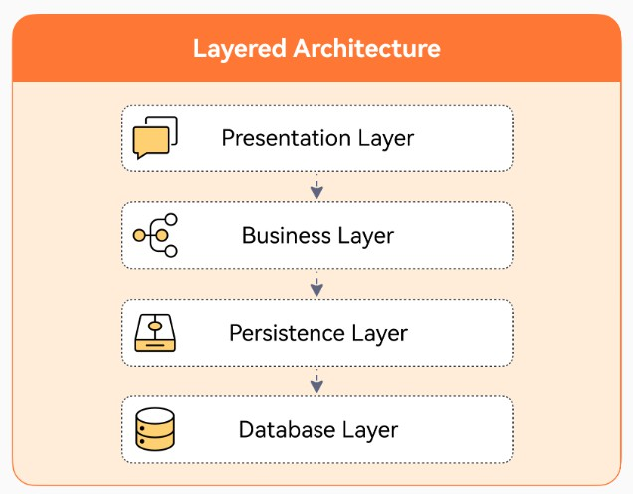
Layered Architecture
01.2
Vấn đề thường gặp của kiến trúc Layered Truyền thống:
Business logic dễ bị rải khắp các layer
Domain/business logic dễ phụ thuộc infrastructure
Layer tạo ra coupling theo chiều dọc
→ Khó bảo trì, phát triển và thay thế trong tương lai.
→ Để giải quyết các vấn đề đó, các kiến trúc hiện tại sẽ sử dụng business model làm trung tâm, cô lập nó với các yếu tố khác, giúp dễ dàng kiểm thử và thay thế hơn (Inversion of control)
→ Clean Architecture vs Hexagonal Architecture
CLEAN/HEXAGONAL ARCHITECTURE

Slide 5
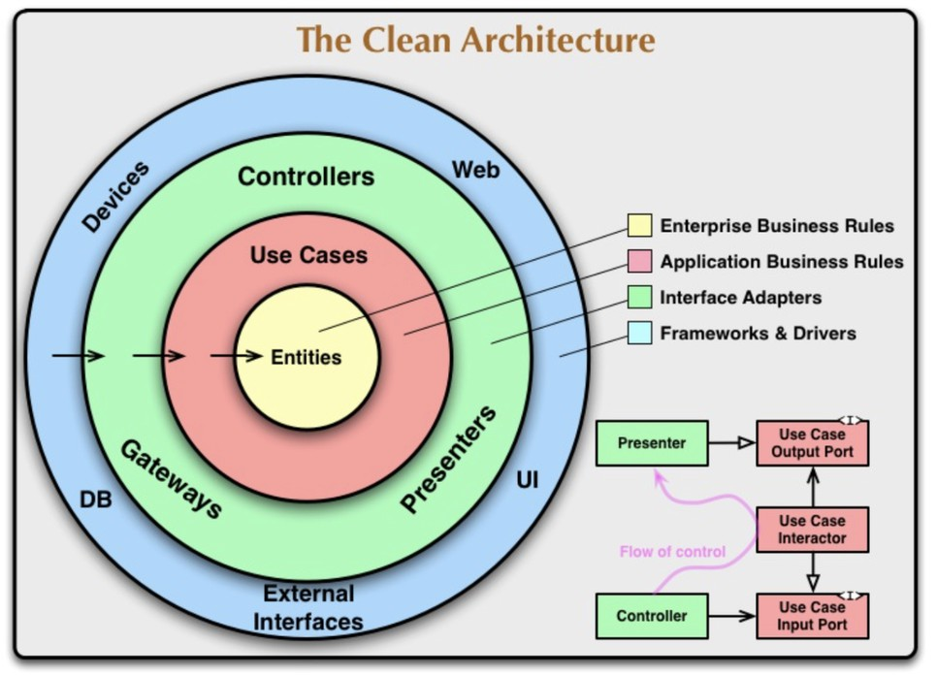
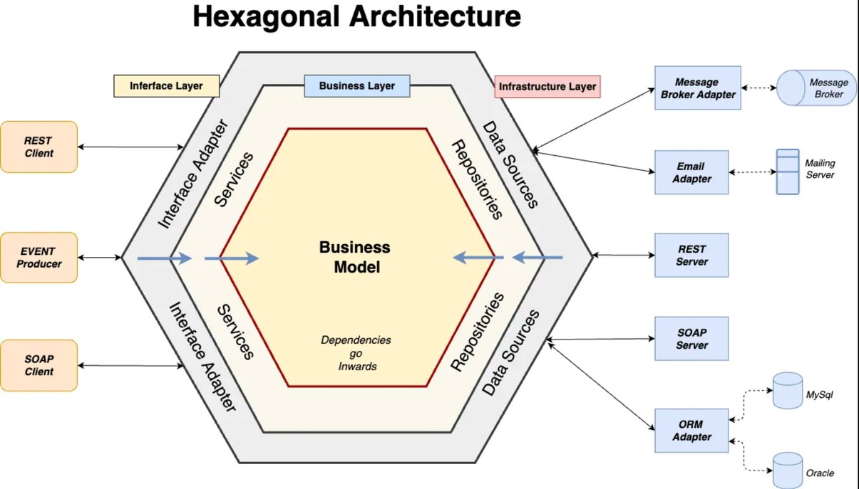
Clean/Hexagonal Architecture
01.3
CLEAN/HEXAGONAL ARCHITECTURE

Slide 6
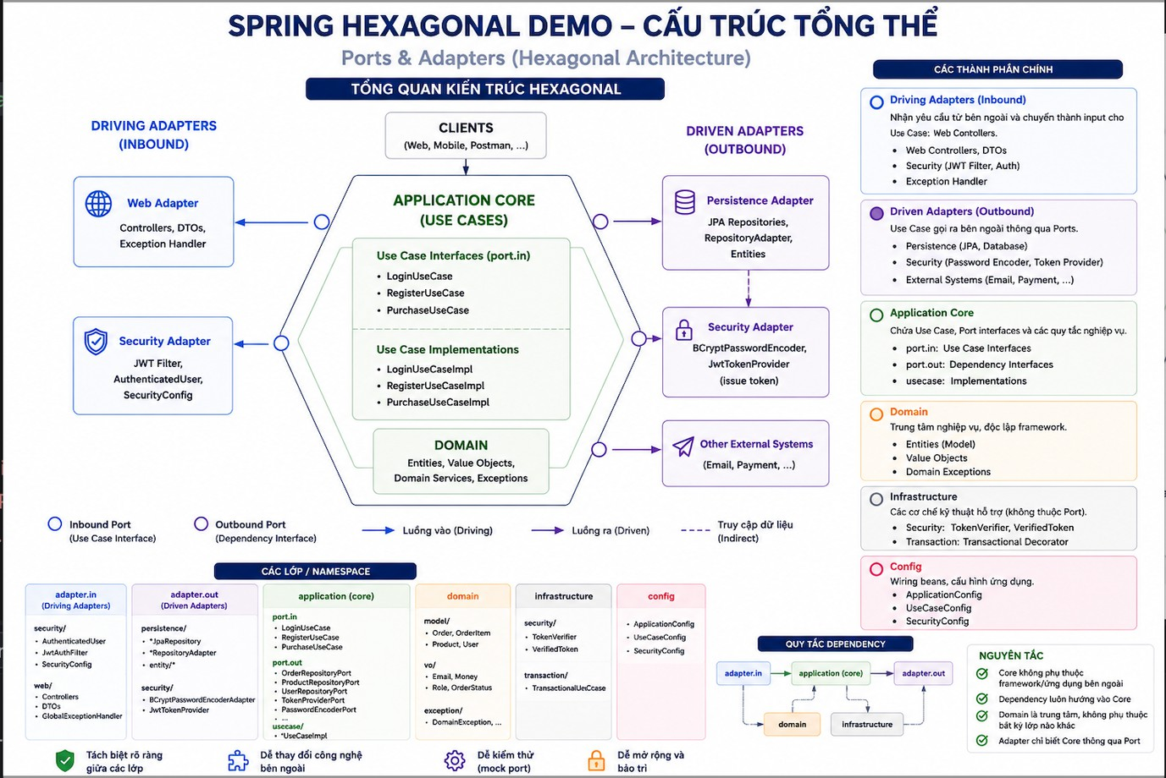
Hexagonal Architecture
01.4
CLEAN/HEXAGONAL ARCHITECTURE

Slide 7
Practice 1: Hexagonal Architecture
01.5
https://github.com/r ichard-truong/spring-ai-demo
CLEAN/HEXAGONAL ARCHITECTURE

Slide 8
Spring AI
02

Slide 9
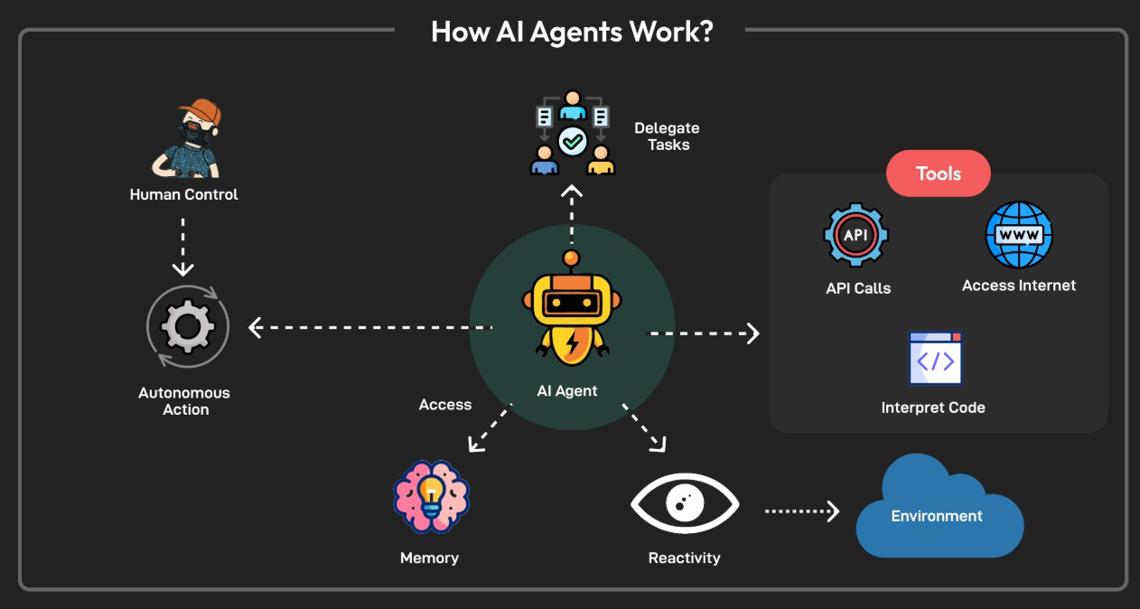
AI Agent
02.1
AI Agents are software systems that use AI to pursue goals and complete tasks on behalf of users. They show reasoning, planning, and memory and have a level of autonomy to make decisions, learn, and adapt.
AI Agent = Brain (LLM/Reasoning) + Memory + Tools/Actions
SPRING AI

Slide 10
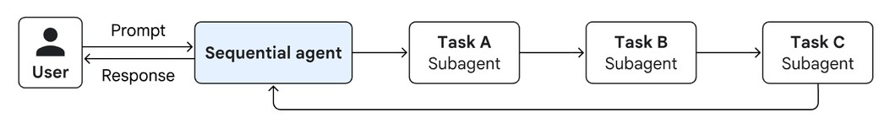
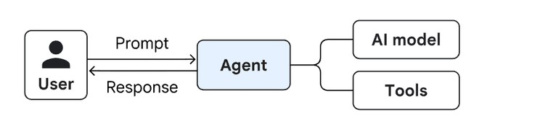
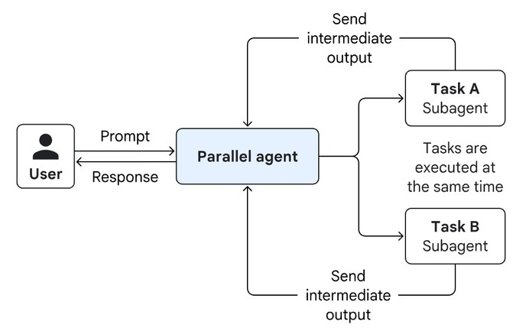
Agentic AI
02.2
While the terms "agentic AI" and "AI agents" are often used together, there is a subtle difference. AI agents are the building blocks of agentic AI. Think of AI agents as individual tools in a toolbox, while agentic AI is the coordinated use of those tools to build an entire house.
Single-agent system
SPRING AI
Multi-agent systems

Slide 11
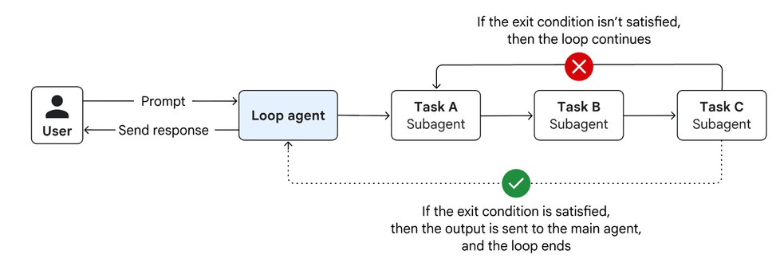
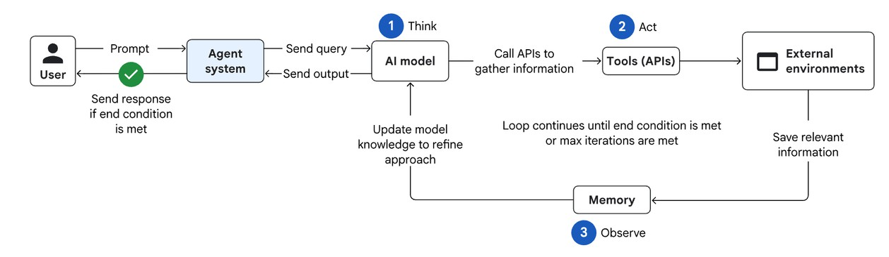
Agentic AI
02.3
While the terms "agentic AI" and "AI agents" are often used together, there is a subtle difference. AI agents are the building blocks of agentic AI. Think of AI agents as individual tools in a toolbox, while agentic AI is the coordinated use of those tools to build an entire house.
SPRING AI

Slide 12
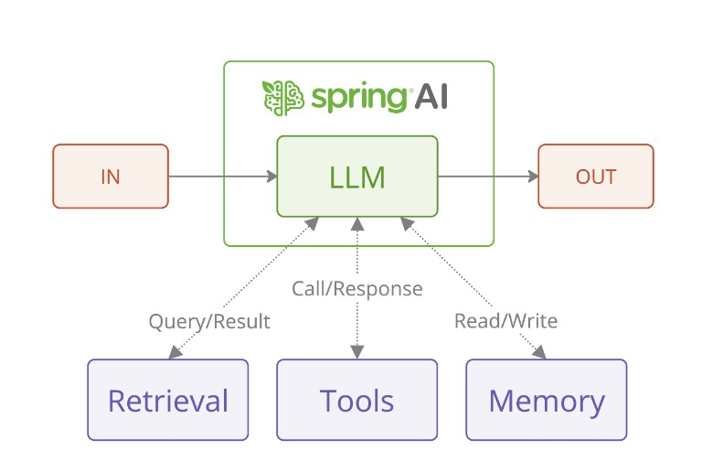
Spring AI
02.4
Support for all major AI Model providers such as Anthropic, OpenAI, Microsoft, Amazon, Google, and Ollama. Supported model types include: Chat Completion, Embedding, Text to Image, Audio Transcription, Text to Speech, Moderation
Portable API support across AI providers for both synchronous and streaming API options are supported. Access to model-specific features is also available.
Structured Outputs - Mapping of AI Model output to POJOs. Support for all major Vector Database providers such as Apache Cassandra, Azure Vector Search, Chroma, Milvus, MongoDB Atlas, Neo4j, Oracle, PostgreSQL/PGVector, PineCone, Qdrant, Redis, and Weaviate.
Portable API across Vector Store providers, including a novel SQL-like metadata filter API.
Tools/Function Calling - permits the model to request the execution of client-side tools and functions, thereby accessing necessary real-time information as required.
Support for Chat Conversation Memory and Retrieval Augmented Generation (RAG).
SPRING AI

Slide 13
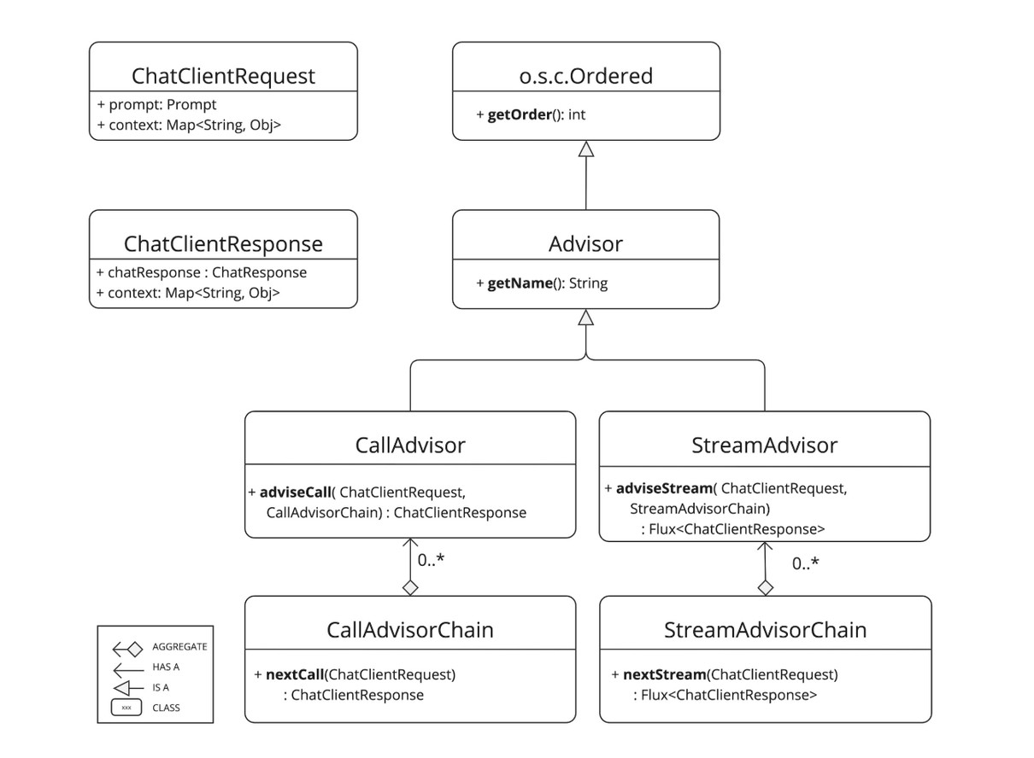
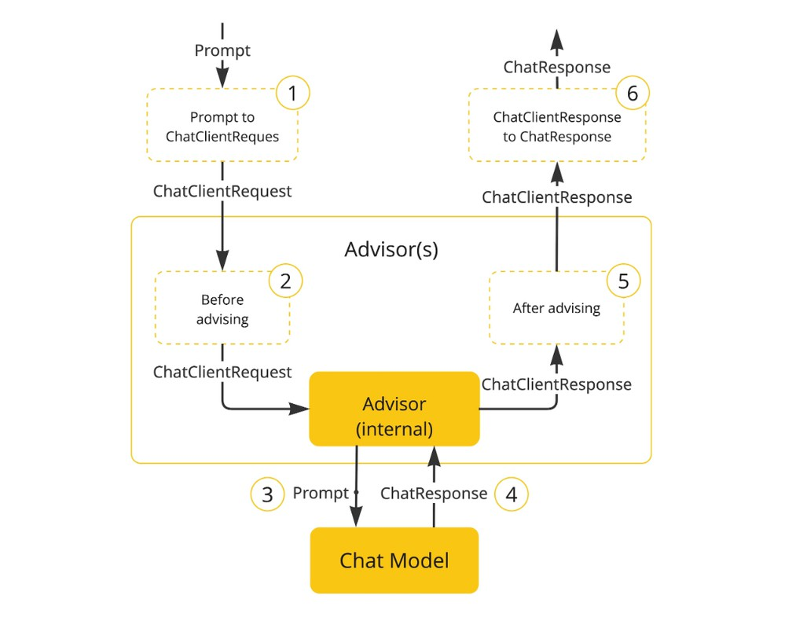
Spring AI Core Concept - ChatClient
02.5
SPRING AI

Slide 14
Practice 2: Spring AI
02.6
https://github.com/r ichard-truong/spring-ai-demo
SPRING AI

Slide 15
Sumary
Hiểu về kiến trúc Clean/Hexagonal Architect
Tìm hiểu về Spring AI và phát triển ứng dụng đầu tiên

